Slide 1
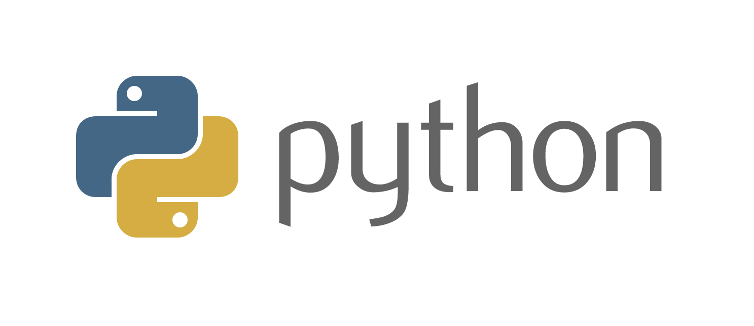
ISA 630 – Machine Learning for Business Applications
Introduction to Python for ML
Module 0

Slide 2
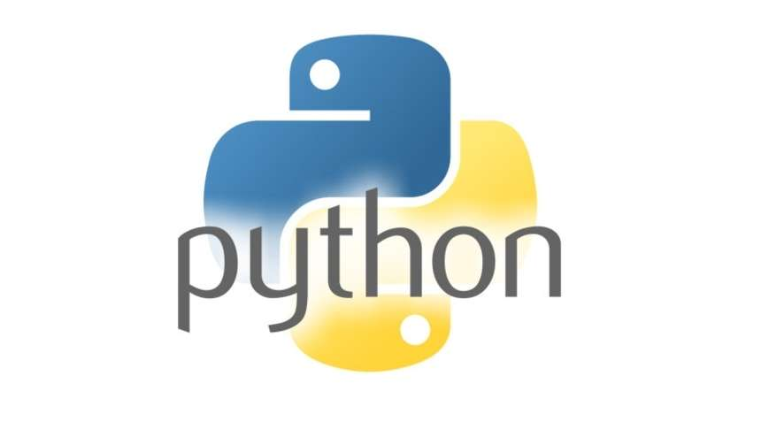



Module 0 [1] - PYTHON
There are many ways you can use Python in this course. If you already have a preferred way of using Python you are welcome to keep it.

Slide 3
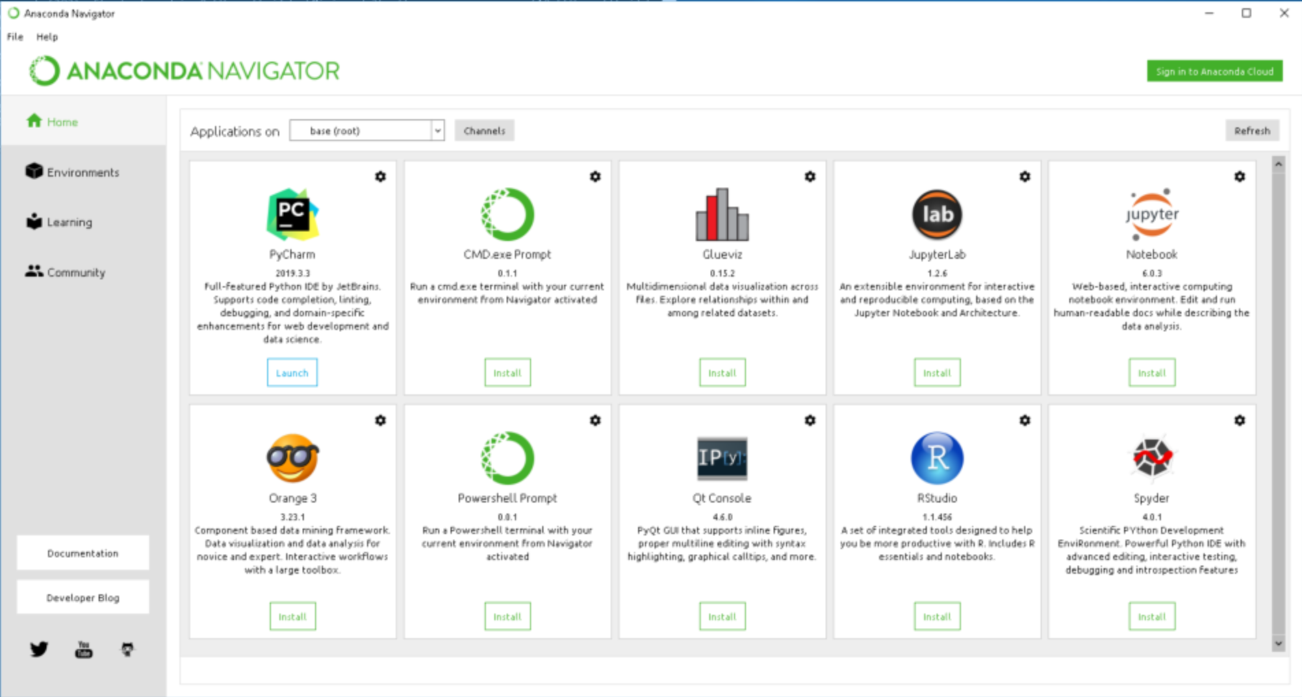
Module 0 [1] - ANACONDA
Anaconda is a open-source distribution of the Python that simplifies package management. Allows for the creation

Slide 4
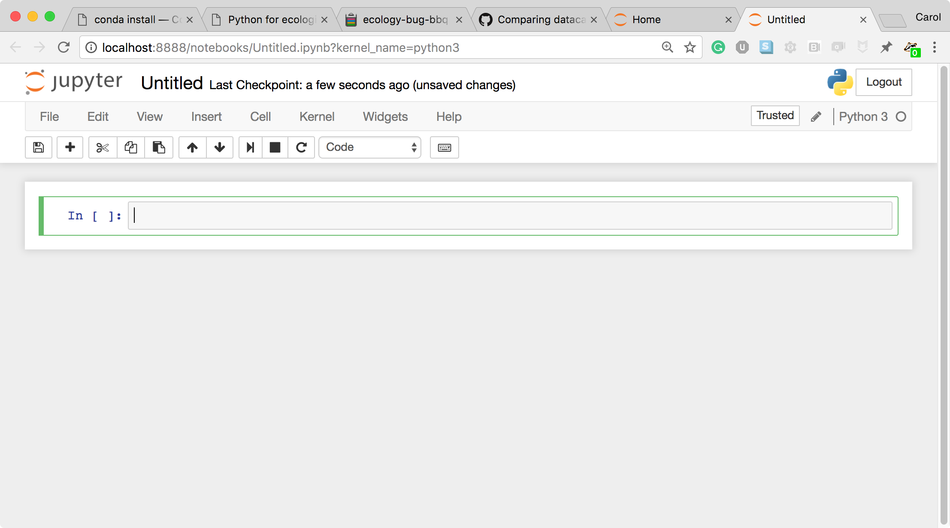
Module 0 [1] – JUPYTER NOTEBOOKS
The Jupyter Notebook is an open-source web application that allows you to create and share documents that contain live code, equations, visualizations and narrative text..

Slide 5
SUMMARY
Make a folder (or several) and keep your data files there.
Remember to set your working directory prior to trying to import data.
Everything is an object, your read.table() statement has to be assigned to something (give it a name) before you read it in.
Use copy and paste as much as you can to avoid typos.
The Global Environment can give you information about objects.
class() function tells you what type of object something is.
The object type and variable type are important!
A data frame can contain variables of multiple types, but each variable needs to have the same number of rows.

